Slide 1


Introduction to
Robotic Process Automation
Online Food Ordering Bot
Register No: 220701112
Name: John Prathap Singh S
Guide Name: Mrs. J. Jinu Sophia
Assistant Professor (SG)

Slide 2
Abstract
Automating Online Food Ordering with UiPath
Overview:
This project utilizes UiPath Robotic Process Automation (RPA) to streamline the online food ordering process on Domino’s. By automating user input collection (city, dish, food type), restaurant search, and order placement, the solution ensures efficiency and accuracy.
Workflow Highlights:
User Inputs: Collected through interactive dialogs.
Data Handling: Automated search, filtering, and item selection based on user preferences.
Order Processing: Quantity adjustments via looping and automated checkout.
Key UiPath Activities: Input Dialog, Type Into, Click, Data Scraping.
Error Handling: Manages invalid inputs and missing data.
Benefits:
Reduces manual effort.
Enhances speed and accuracy.
Improves user convenience.
Demonstrates RPA's potential in optimizing digital processes.

Slide 3
Need for the Proposed System
Aims to
Reduce manual effort:
By automating repetitive tasks, reducing manual efforts and saving time.
It accelerates the entire ordering process, ensuring quick and consistent execution.
Reduce Mistake:
Minimizes human errors during order placement.
Make more Scalability:
As the volume of orders increases, manual processing becomes inefficient and unmanageable.
An automated system can easily scale to handle a large number of orders without additional human resources.

Slide 4
Advantages of the Proposed System
Increased Efficiency:
It free up time for users and employees by doing repetitive tasks and making it quicker and more efficient than manual input.
Error Reduction:
Reduces the likelihood of human errors in order processing.
User-Friendly Experience:
Provides a seamless and user-friendly experience, enhancing customer satisfaction with timely order confirmations and updates.
Scalability:
Easily handles a high volume of orders, adapting to different user requirements without compromising performance.
Cost Savings:
Reduces the need for manual labor, lowering operational costs associated with order processing.
Enhanced Data Management:
Efficiently collects and integrates user data into structured formats, ensuring real-time updates and better data synchronization.

Slide 5
Literature Survey
Advantages:
Increased Efficiency: RPA tools operate 24/7 and execute tasks faster than humans, leading to significant time savings.
Error Reduction: Automating repetitive tasks minimizes the risk of human error, improving accuracy.
Scalability: RPA bots can scale up operations during peak times (e.g., processing bulk orders during festive sales).
Cost Savings: Once deployed, RPA reduces operational costs by minimizing reliance on manual labor.
Integration Without Infrastructure Changes: RPA can be implemented without altering existing IT infrastructure.
Disadvantages:
Fragility in Changing Environments: Bots relying on UI elements are sensitive to changes in web page design, requiring frequent updates.
Implementation Challenges: Setting up RPA requires careful planning to identify processes suitable for automation.
Limited Learning Capabilities: Traditional RPA lacks adaptability unless paired with AI or machine learning.
High Initial Investment: While RPA leads to savings over time, the initial setup can be costly for smaller businesses.

Slide 6
Main Objective
This project aims to automate the online food ordering process using UiPath, enhancing efficiency by preforming repetitive tasks like searching for dishes, applying filters, selecting quantities, and placing orders.
The bot interacts with users to collect essential inputs (dish name, preferences, quantity) and navigates the website like Swiggy, Zomato, etc to extract structured data (dish names, prices, ratings). It then selects the desired dish, adjusts quantities, and completes the checkout process.
Key Objectives:
1. Automate Online Food Ordering: Simplify the process from searching to placing an order.
2. Reduce Manual Effort: Minimize user intervention in repetitive web tasks.
3. Enhance Efficiency: Ensure faster and more accurate task execution.

Slide 7
Architecture
Input Layer:
Receives inputs through dialog boxes.
Inputs dynamically control the subsequent steps in the automation process.
Process Layer:
Utilizes an RPA tool to interact with a web browser. Includes actions like opening the browser, typing into search fields, clicking buttons, and extracting data.
Captures and processes data extracted from the website. Implements conditional logic for decision-making
Data Layer:
Uses variables to store and update dynamic values
Temporarily stores extracted data for processing or passes it as parameters between activities.
Output Layer:
Executes final actions like navigating to the cart or confirming orders.
Automates end-to-end processes, such as navigating pages, adding items, and completing actions like placing orders.

Slide 8
System Requirements
Hardware:
CPU:
Minimum 2 x 1.8 GHz 32-bit (x86) processor;
Recommended 4 x 2.4 GHz 64-bit (x64) processor.
RAM:
Minimum 4 GB of usable system memory;
Recommended 8 GB of RAM.
Disk Space:
Minimum 3.5 GB for new installations
Recommended 5 GB for upgrades.
Resolution: Minimum screen resolution of 1024x768.
Software:
Operating System: Windows 8.1 and above.
.NET Framework: Version 4.6.1 or greater.
Web Browsers: Google Chrome (version 64 or greater), and Microsoft Edge on Windows 10
Microsoft Office: Office 2013, Office 2016, Office 2019, or Office 365.
Microsoft Visual C++ Redistributable

Slide 9
Functional Description
Name of the Module:
"Web Automation Workflow for Food Ordering"
Description:
This module automates a food ordering process on a website. It performs tasks such as:
Opening a browser and navigating to the food ordering website.
Filtering options like "Veg" or "Non-Veg."
Searching the dishes based on user input.
Adding items to the cart.
Proceeding to the checkout page.

Slide 10
Process Design
Start
Open browser and navigate to the food ordering website.
Filter
Prompt user to select "Veg" or "Non-Veg."
Apply the selected filter.
Search
Prompt user for the dish name and input it into the search bar.
After entering the dish name, dish will be displayed.
Add Items
Select an item, specify the quantity, and click Add to Cart.
Use a loop to allow adding more items for the particular dish.
Checkout
Navigate to the cart page, review items, and click Checkout.
End
Display confirmation and close the browser.

Slide 11
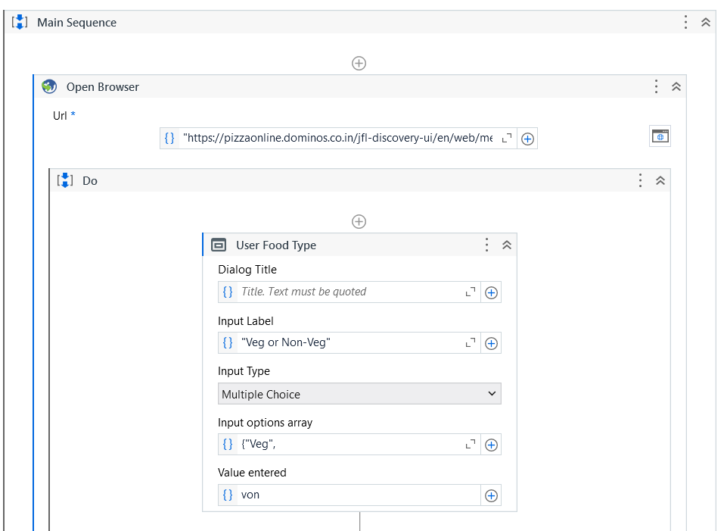
Implementation

Slide 12
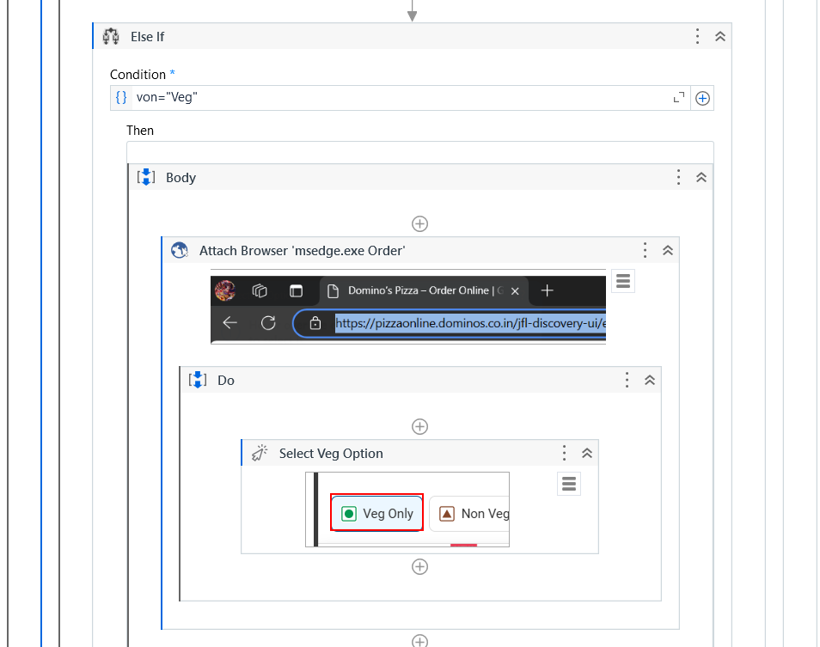
Implementation

Slide 13
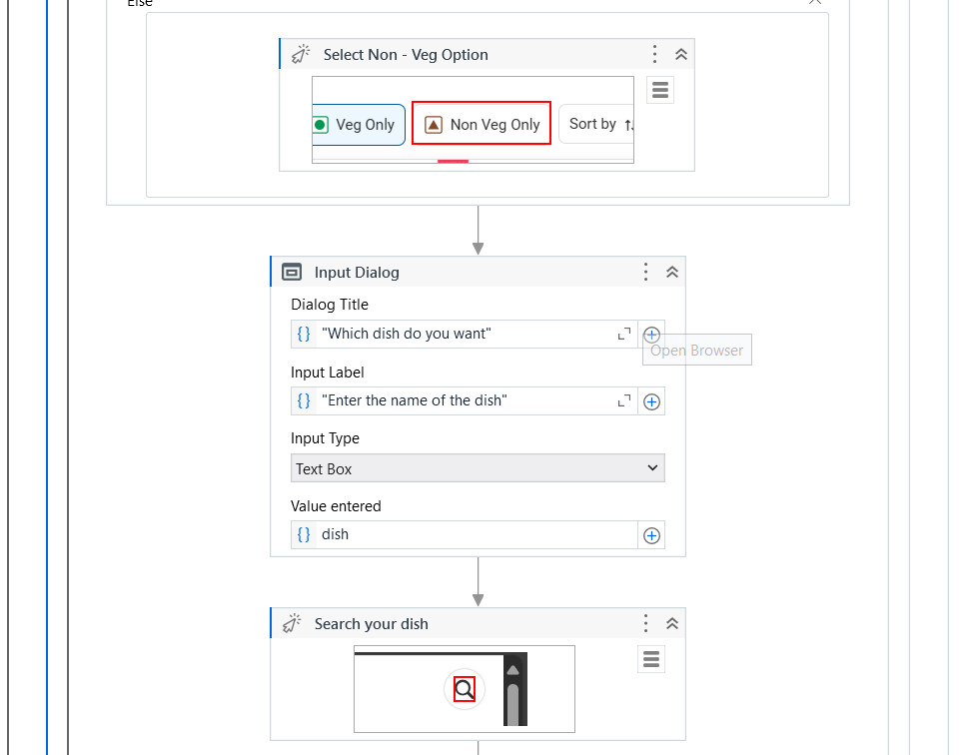
Implementation

Slide 14
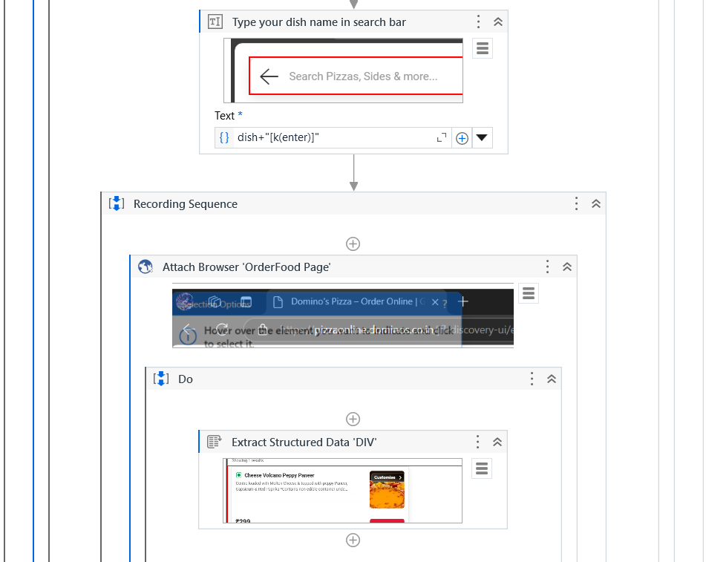
Implementation

Slide 15
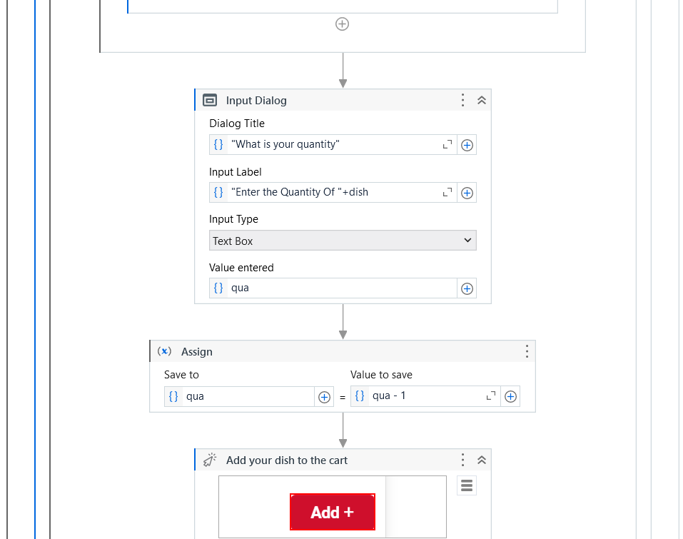
Implementation

Slide 16
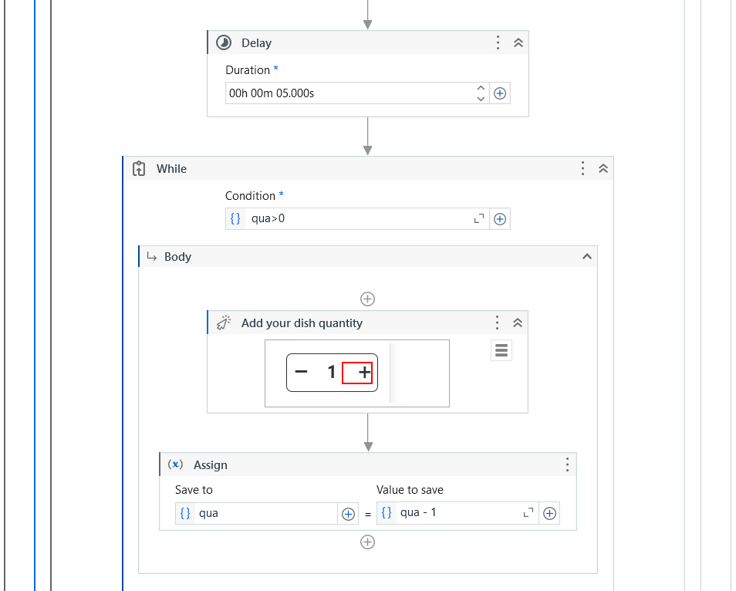
Implementation

Slide 17
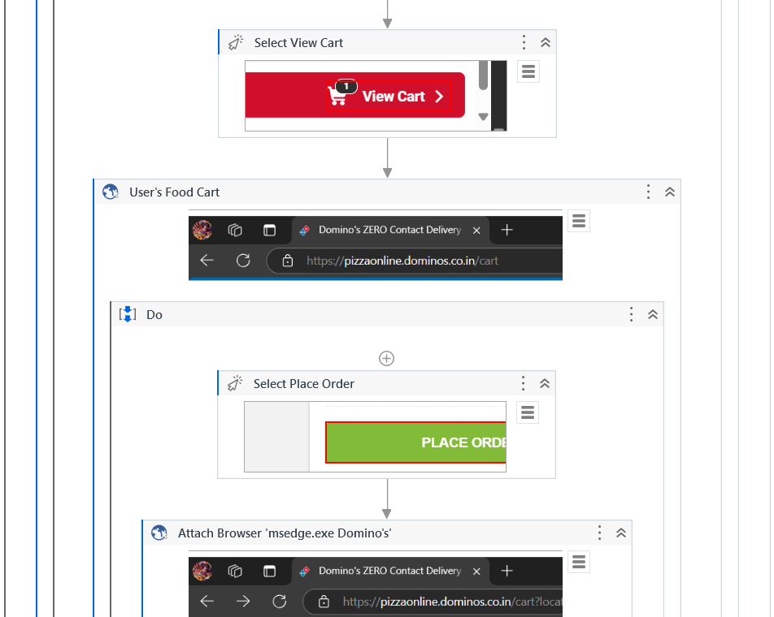
Implementation

Slide 18
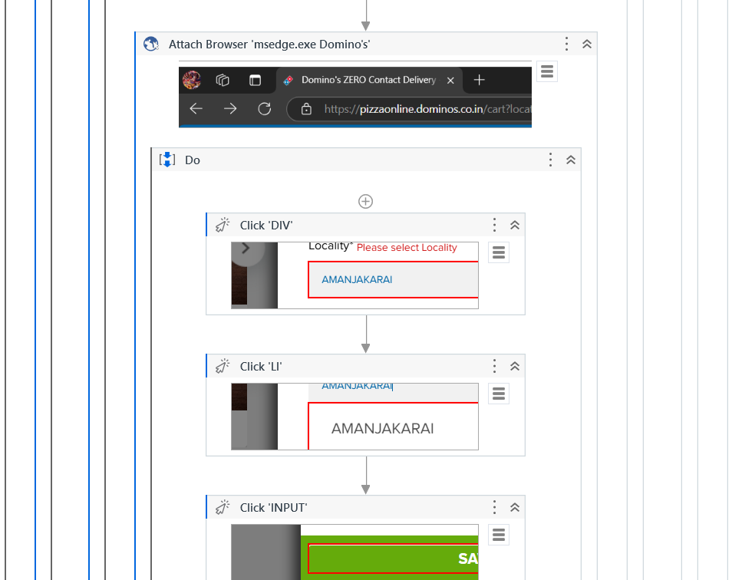
Implementation

Slide 19
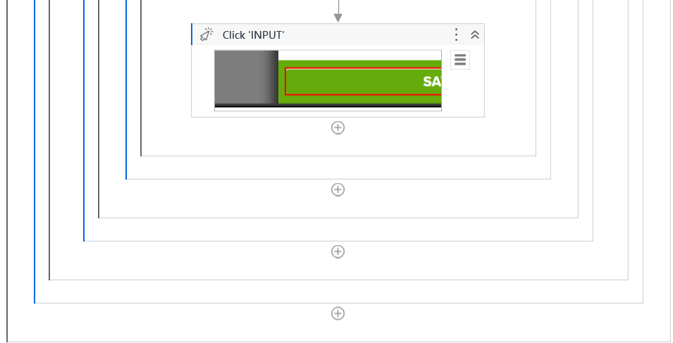
Implementation

Slide 20
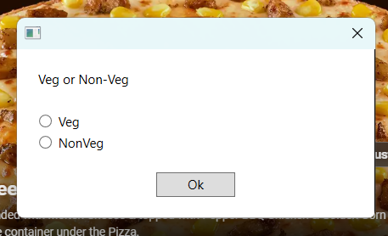
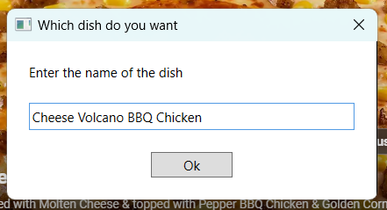
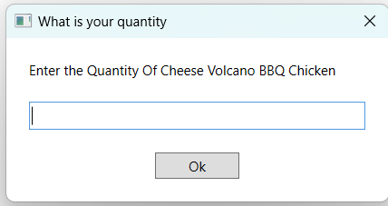
Testing

Slide 21
Conclusions
The project successfully demonstrates the potential of RPA to streamline repetitive and time-consuming tasks, such as ordering items from a food delivery platform.
By automating processes like searching for dishes, selecting preferences, and adding items to the cart, the workflow reduces human effort, minimizes errors, and enhances operational efficiency.
The dynamic decision-making capabilities, such as Veg/Non-Veg selection, and the ability to handle user inputs make the automation adaptable and user-friendly.

Slide 22
Future Enhancement
Multi-Site Support
Automate ordering across multiple platforms (e.g., Zomato, Uber Eats).
Dynamic Inputs
Accept batch orders via file uploads (e.g., CSV/Excel).
Personalization
Integrate user preferences like dietary restrictions and favorite cuisines.
Error Handling
Advanced logging and retry logic for network/site failures.
Payment Integration
Automate secure payments via integrated gateways.
Real-Time Notifications
Send order updates via email, SMS, or WhatsApp.
AI-Powered Search
Enable conversational queries for seamless searching.
Scheduled Orders
Add support for scheduling future orders.

Slide 23
IEEE Paper
UiPath Official Website
Comprehensive guides, tutorials, and community forums.
https://www.uipath.com/resources
Automation Anywhere Blog
Articles on automation trends, best practices, and use cases.
https://www.automationanywhere.com/blog
Blue Prism Learning Resources
Resources to explore RPA concepts and implementations.
https://www.blueprism.com/resources/
Stack Overflow
A go-to platform for troubleshooting RPA workflows and code-related issues.
link: https://stackoverflow.com/
GitHub RPA Repositories
Open-source RPA scripts, projects, and tools.
link: https://github.com/topics/rpa

Slide 24
Thank You

